Slide 1
Customizing Hibernate with Annotations (and more)
Scott Faria

Slide 2
Why?
Automate common or error-prone behaviors in your Hibernate-driven application.
Inject behavior in existing applications (audit logging, etc.).
Overcome shortcomings in Hibernate and/or your RDBMS (Seriously, Oracle, why is there no bool type?).

Slide 3
How?
There’s a few ways of customizing the runtime behavior of Hibernate:
Callback methods.
Entity listeners.
Interceptors.

Slide 4
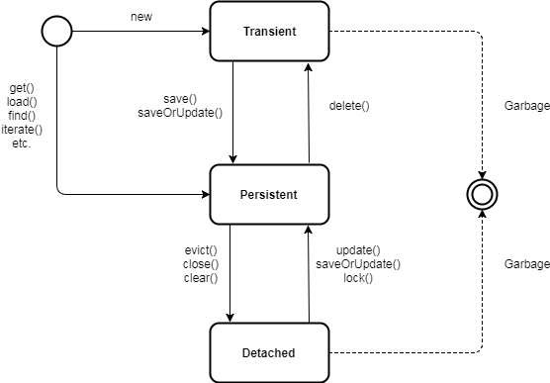
But first a quick word on the hibernate lifecycle…

